Slide 1
Dynamics 365 Online
Examples

Slide 2
Examples
Plugin.
Workflow.
REST API.

Slide 3
Plugin
Validate fields.
Change field values.
Pass and receive parameter from form to plugin.
Get data from dynamics 365 REST web api and redirect page.

Slide 4
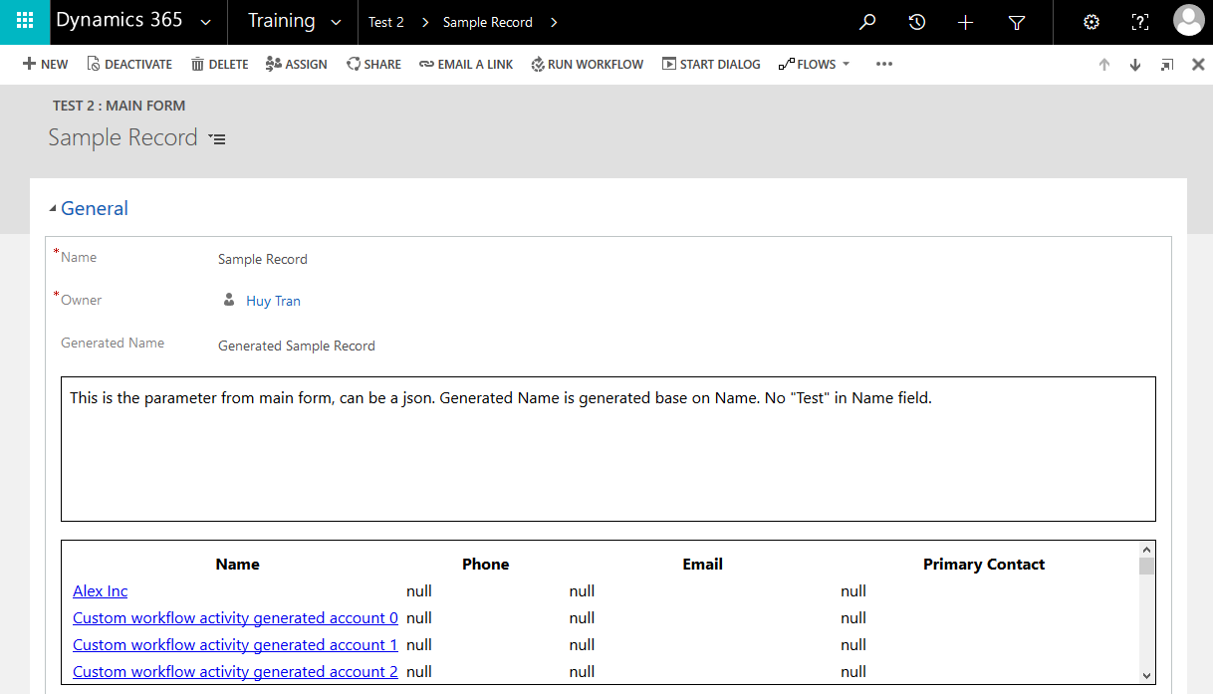
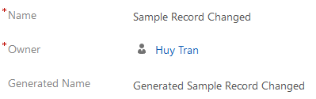
Validate
Update “Generated Name” on “Name” field value changes
Parameter from main form
Data from Dynamics REST web api.
Click to redirect to edit form.

Slide 5
Workflow
Scheduled workflow with given time.
Custom workflow for creating accounts.
Pass and receive parameter in custom workflow.

Slide 6
Scheduled workflow
Run workflow
Perform main action
Wait
Start workflow

